Slide 1
Secure Storing and Sharing of office Data Using Cloud Computing
SUBMITTED BY
EMIL ELDHOSE

Slide 2
RELEVANCE OF TOPIC
Cloud file storage is a method for storing data in the cloud that provides servers and applications access to data through shared file systems.
This compatibility makes cloud file storage ideal for workloads that rely on shared file systems and provides simple integration without code changes.
Cloud file sharing can be defined as a service that provides simultaneous access for multiple users to a common set of file data in the cloud.
Security for file sharing in the cloud is managed with user and group permissions enabling administrators to tightly control access to the shared file

Slide 3
DESCRIPTION
Cloud computing is an emerging paradigm that aims to provide computing resources, massive data storage capacity and, flexible data sharing services.
The explosive growth of data produced persuade business and users, driven by the cloud-top features, to outsource their data to the cloud storage systems.
Data must be encrypted prior to storing it in the, potentially untrustworthy cloud.
The key management is conveniently designed. In order to ensure robust data sharing security
Security analysis indicates that it is extremely secure and robust against attacks such as brute-force, eavesdropping, man-in-the-middle, and offline-dictionary attacks.

Slide 4
OBJECTIVE
Storing file data in the cloud delivers advantages in three key areas:
1. Scalability - Although not every cloud file storage solution can scale, leveraging all the capabilities of the cloud, the most advanced solutions provide the ability to start with the capacity and performance you need today and grow your capacity as needed. No more over provisioning to try and anticipate future needs.
2. Interoperability - Many existing applications require integration with shared file services that follow existing file system semantics. Cloud file storage solutions offer a distinct advantage as there is no new code to write to have secure, shared file access.
3. Budget and Resources - Operating file services on-premises requires budget for hardware, ongoing maintenance, power, cooling, and physical space. Cloud file storage enables organizations to redeploy technical resources to other projects that bring more value to the business.

Slide 5
EXISTING SYSTEM
Traditional encryption applications, generally, suffer from limited usability due to the manual solution provided by applications.
Data owners must encrypt their data manually prior to uploading to the cloud. Moreover, users have to manually generate, manage, and store the encryption keys. However, the involvement of data owners in performing multiple encryption and decryption operations.
It is time consuming
it is difficult for users to manage more than a few keys, and if the keys are leaked or otherwise compromised, security will be threatened.

Slide 6
PROPOSED SYSTEM
The proposed fie system is designed to work atop third-party cloud tools to allow data owner storing his/her files in an encrypted manner
PKG will generate the master key pair and send the master public key to the data owner in order to encrypt the file.
All files are stored encrypted in the server, personal files are decrypted by the data owner only, whereas the shared files can be decrypted by the authorized user using the private key obtained from the PKG server. Any unauthorized user will not be able to decrypt or alter the files.

Slide 7
FRONT END AND BACKEND
FRONT END : HTML,CSS
BACKEND : PYTHON

Slide 8
ALGORITHM
Advanced Encryption Standard (AES)
AES is a block cipher.
The key size can be 128/192/256 bits.
Encrypts data in blocks of 128 bits each.

Slide 9
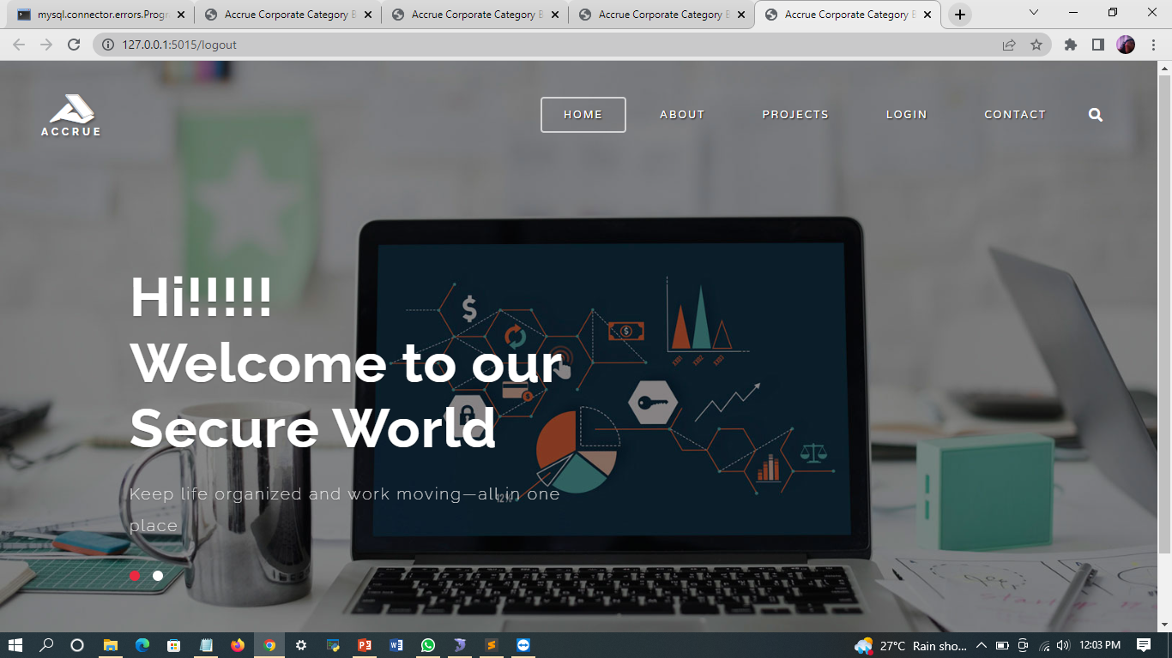
SCREENSHOTS

Slide 10
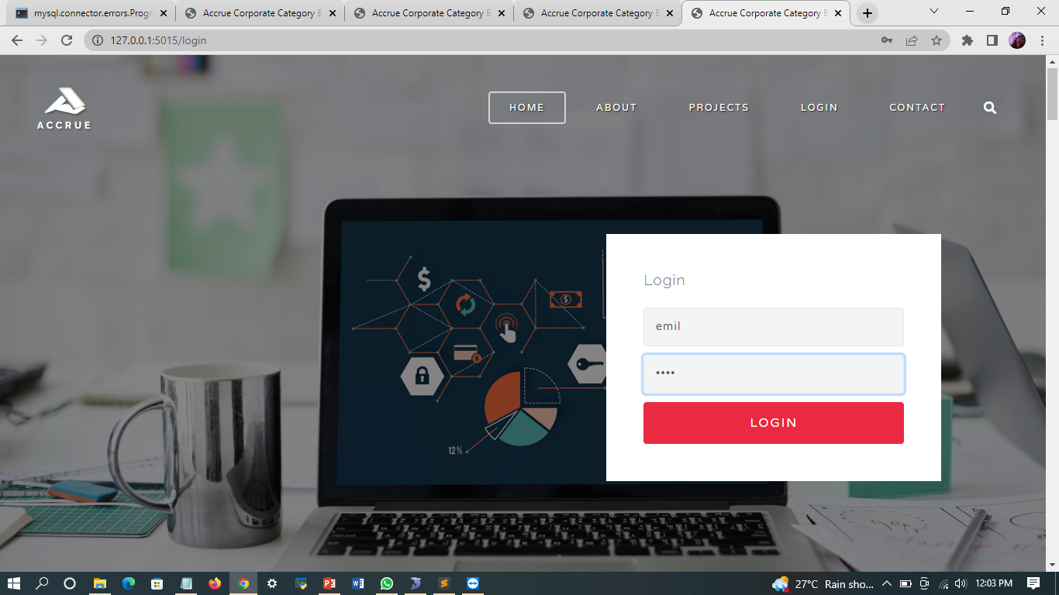

Slide 11
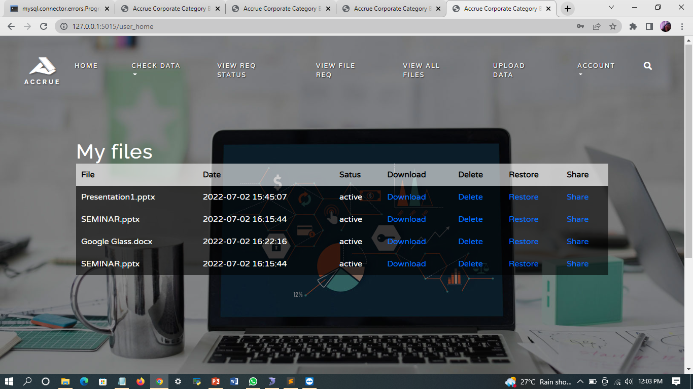

Slide 12
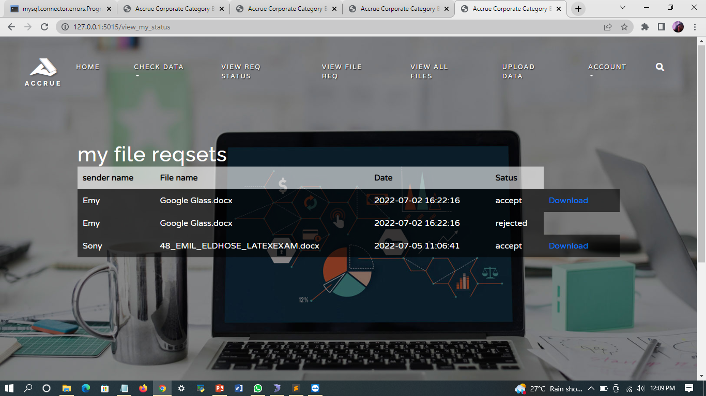

Slide 13
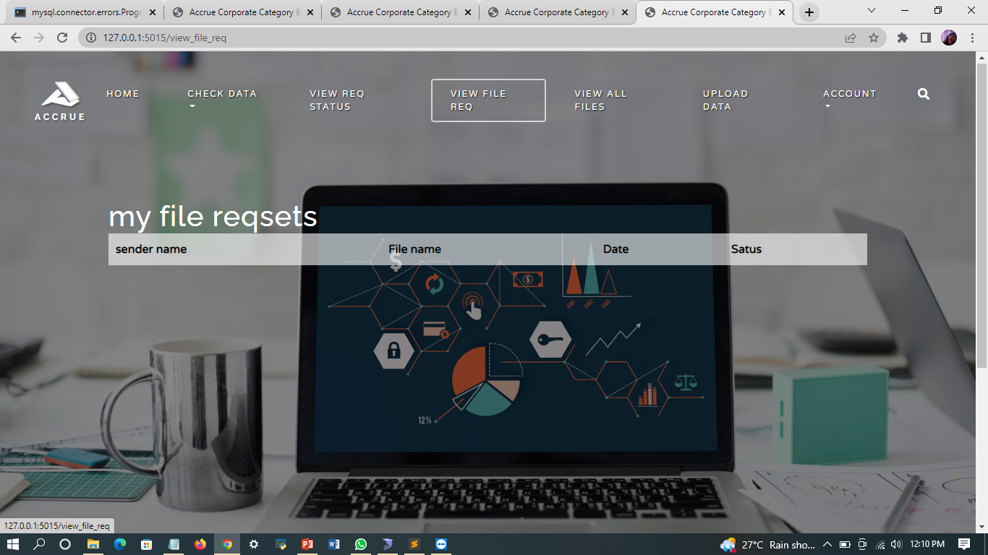

Slide 14
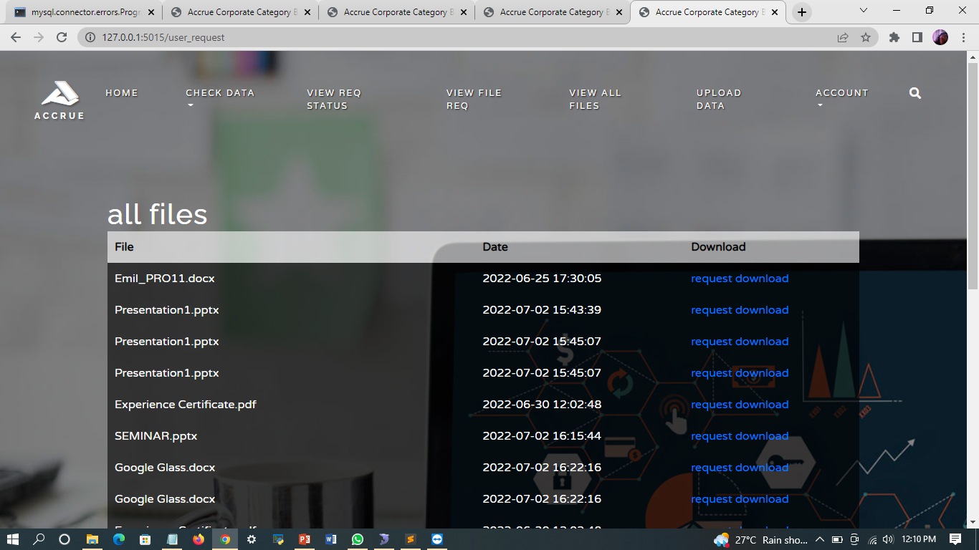

Slide 15
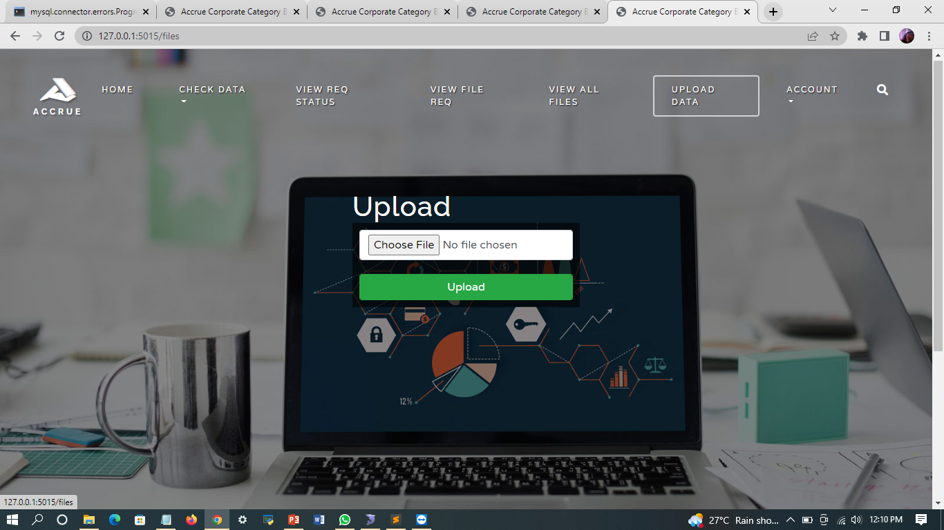

Slide 16
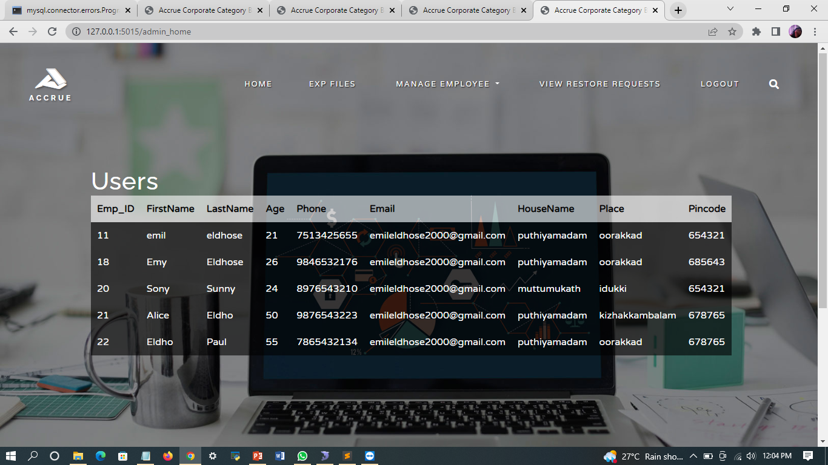

Slide 17
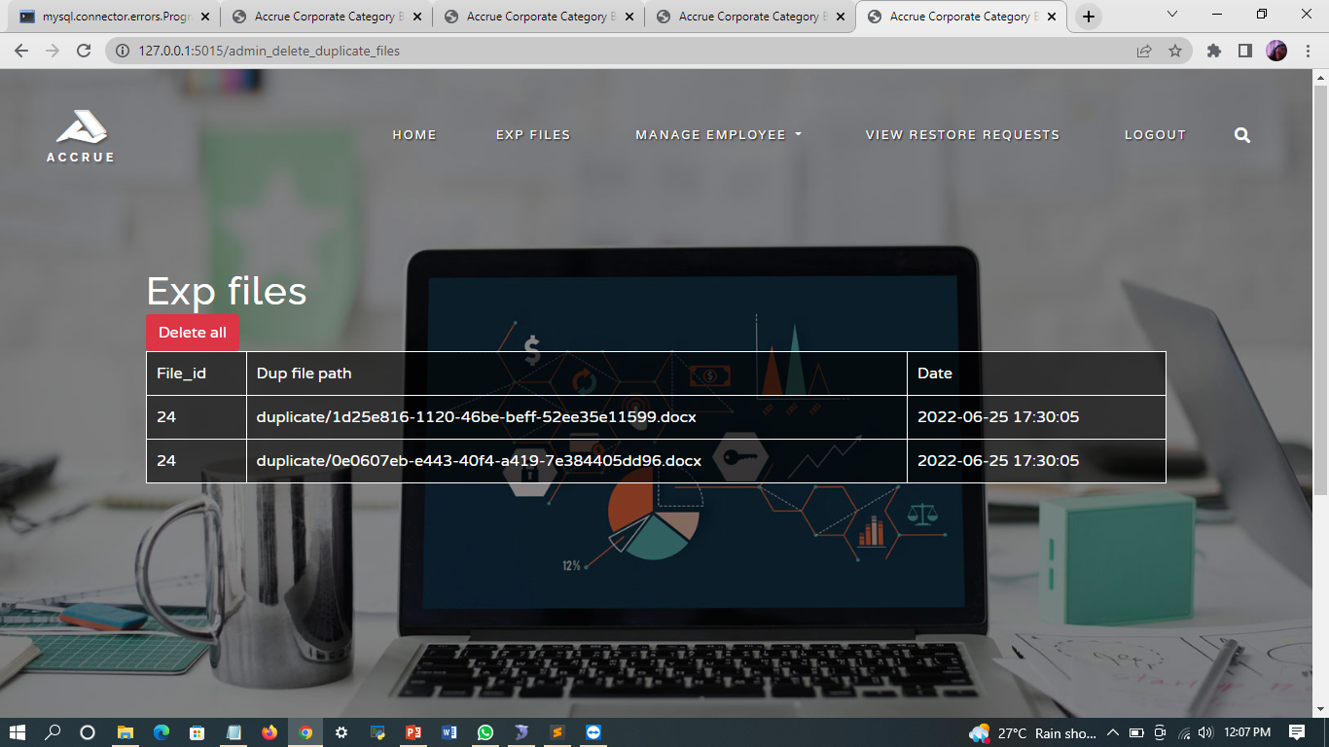

Slide 18
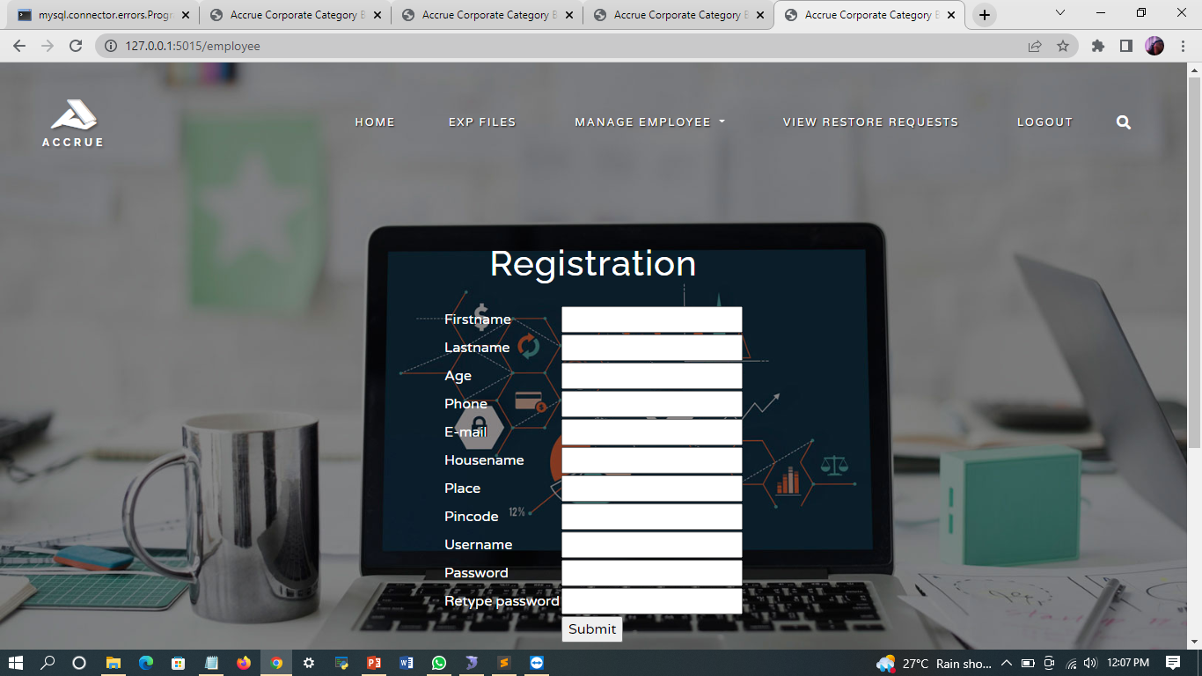

Slide 19
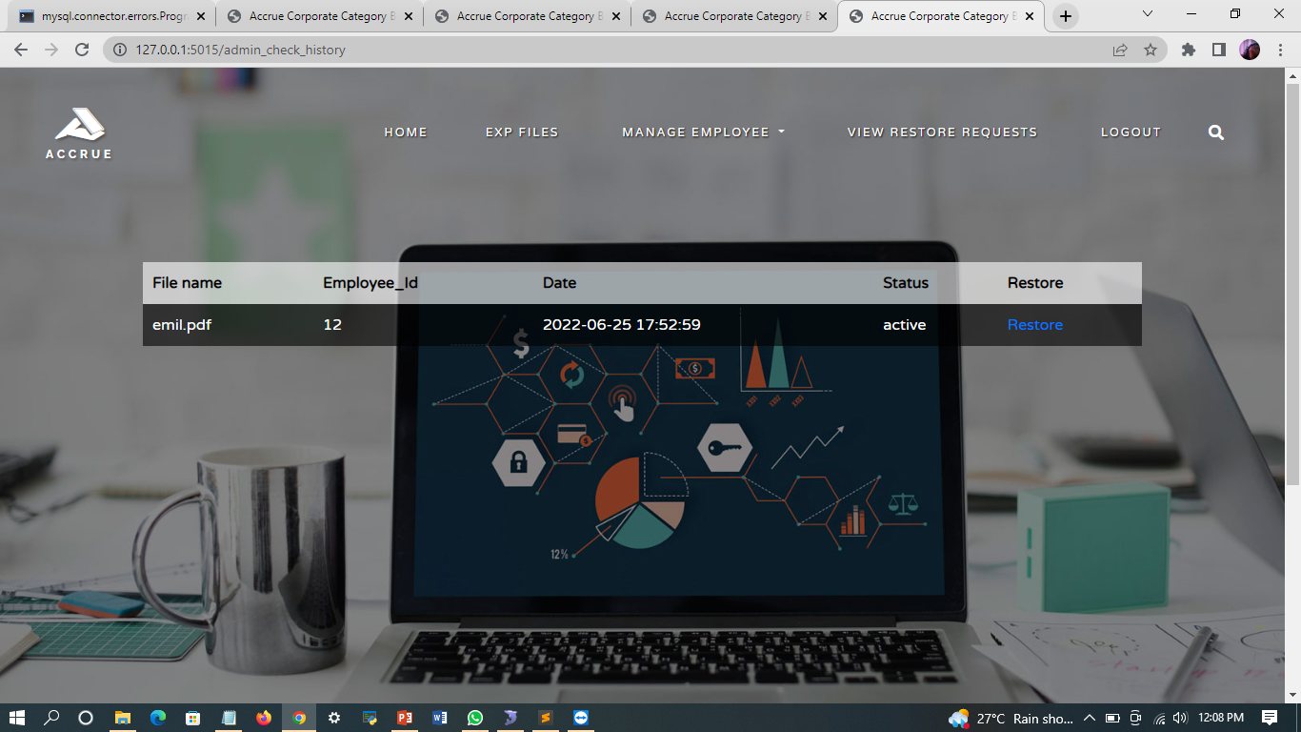

Slide 20
THANK YOU

